Slide 1

Cody L. Strange
10/3/2021-001-016

Slide 2
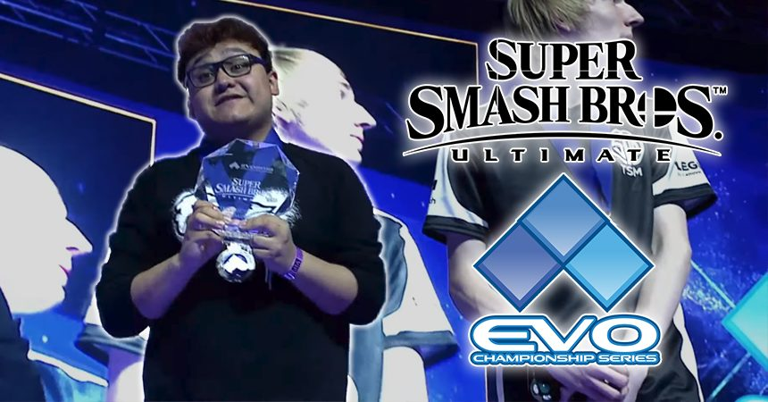
Having a regular training regime
Will increase your Win rate in super smash brothers ultimate
Because having a regular training regime will increase your technical
skill at the game

Slide 3
What lead me to this topic?
I have been playing smash bros casually for all my life and with the newest iteration-Super Smash Brothers ultimate-I have been learning to play it at a competitive level. Recently I had the opportunity to tryout for the UVU esports team in a small tournament. I lost, badly, I realized I wanted to get better in hopes of being successful for next semesters tryouts. I’ve discovered that I don’t know how to get better and unless I change that, I have no hope of achieving my goal.

Slide 4
Research Questions
How important is regular training in competitive sports
What is the value of having a strict training regime in competitive sports
How difficult is it to learn technical skill in Super Smash Bros Ultimate
How important is technical skill in Super Smash Bros Ultimate

Slide 5
What I’ve learned So far
I have over 1,500 hours in SSBU, needless to say, I have picked up a thing or two from experience alone. I have also done some preliminary research to support my claim that having a training regime will increase your win rate in Super Smash Bros Ultimate
Personal Experience:
All technical skill that I have gained
in this game has come from consistent
Practice, and I have won many close
games because of it
Professional Players:
Professional coach, Izaw states the importance of technical skill and even lists out a minor training regime for beginners.
Research:

Slide 6


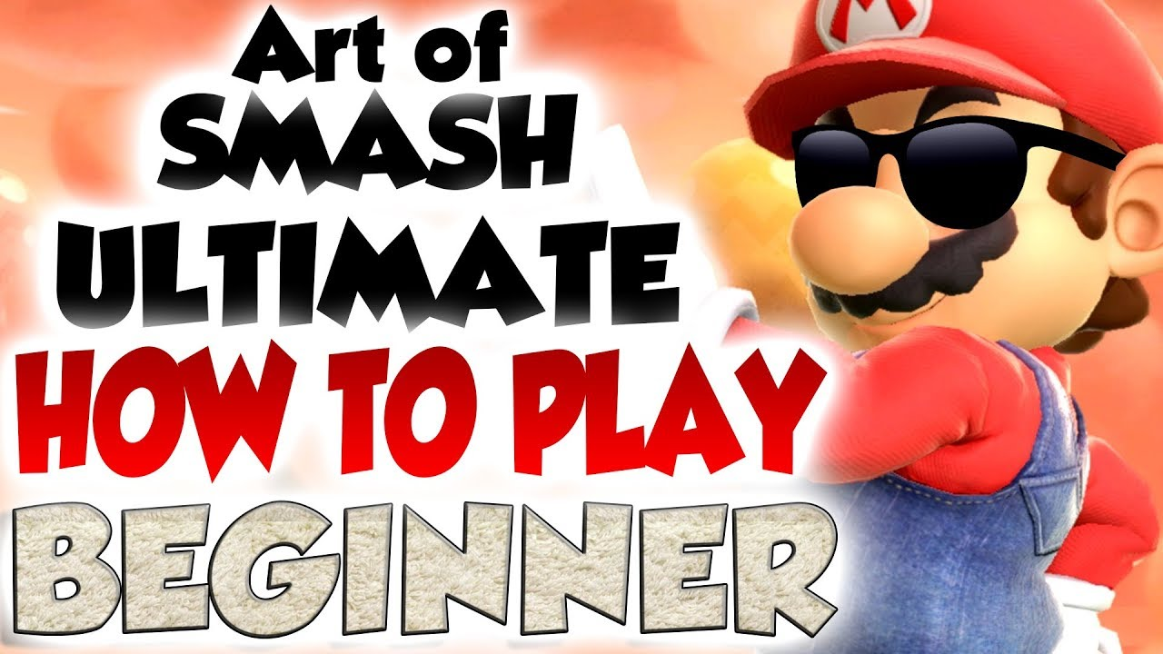
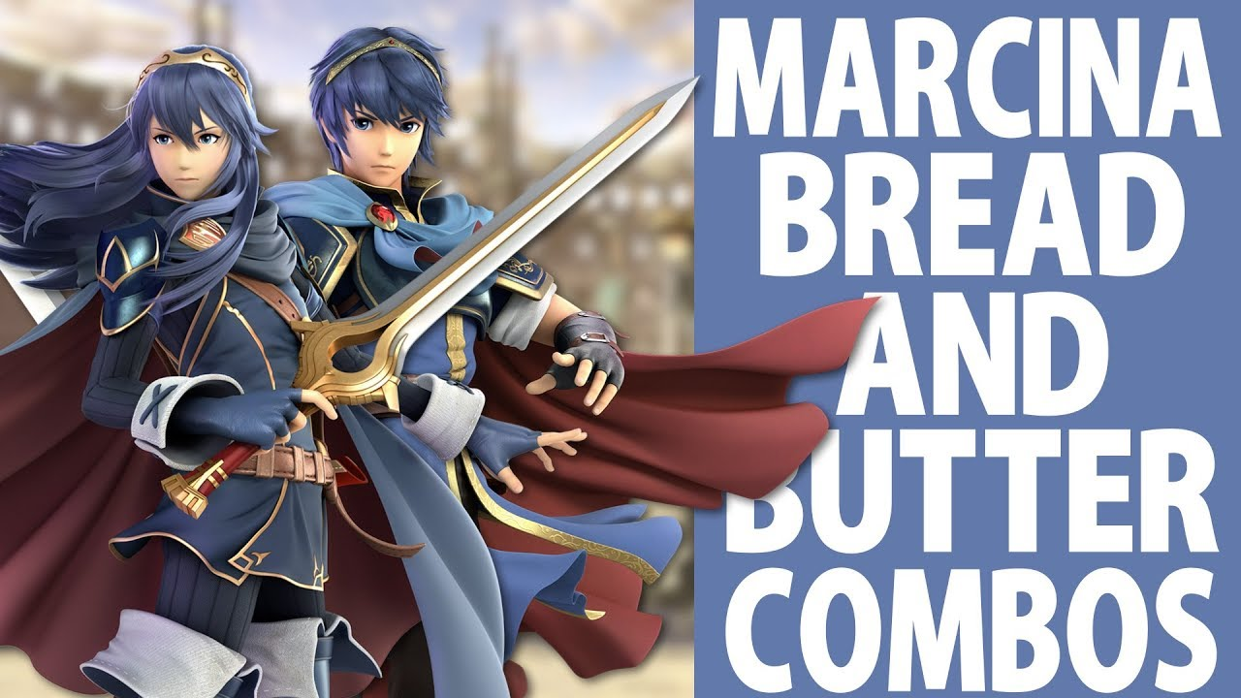
Research Plan
My most valuable research will be primary sources from pro players and their coaches. Completing some primary research of my own is possible but unlikely given the time frame that I have allotted myself. There will be a few key scholarly sources around training regime’s in general that will be very important as well.

Slide 7
Why it matters
Many players such as myself find themselves feeling very stagnate and struggling to improve faster than those around themselves. It matters because my research should prove that creating and sticking to a training regime or schedule will increase the improvement rate and competitive results.

Slide 8
Project Schedule
Structured Research Notes:
10/4 – research mentality in library
10/5 – research mentality on internet
10/6 – write draft for mentality section
10/7 – gather list of videos on YouTube to watch and review. Split them into 4 sections to watch over
10/8:10/11 – watch videos and take notes
10/12 – outline paper with sections for certain types of research
10/13 – rough draft
10/14:10/17 – final draft
Presenting Research Perspectives:
10/21 – identify specific audience and list of general different views
10/25 – expand on specific details for the different views
10/26 – draft for Audience Justification Statement
10/27 – outline paper
10/31 – rough draft
11/1 – final draft
Final Research Paper:
11/2 :11/3 – outline paper
11/4 - rough sketch website
11/9 - rough sketch website
11/11 - rough sketch website
11/13 - final sketch website
11/15:11/17 – rough draft
11/22:11/24 – final draft
11/28 – final draft

Slide 9
Citation
https://www.businessinsider.com/pro-gamers-explain-the-insane-training-regimen-they-use-to-stay-on-top-2015-5
https://journals.plos.org/plosone/article?id=10.1371/journal.pone.0237584
https://www.youtube.com/watch?v=DrBWKkO9OeU&list=PL4SzCzeORbSRRI72fLpdCCDI-SZIwqFyJ&index=5

